Slide 1
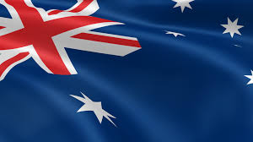
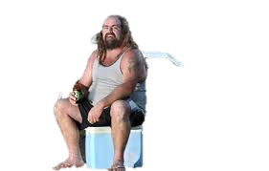
Canberra
‘Stralia’s capital
By
Hamish McManus
(Bruce Smith)

Slide 2
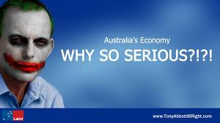
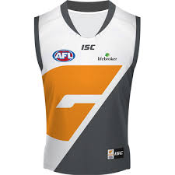
Canberra: Where is Canberra
Canberra is Australia’s capital city, it is an urban city located in the ACT (Australian capital territory). It is mostly buildings and forest’s, It is also home to the GWS Giants and it also has the majority of the other countries embasities, it is also where our government is located.

Slide 3
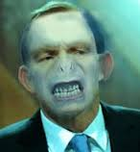
Canberra
Canberra is full of
People that think that they have power
People that have power
Tony Abbott
GWS
Foreign people
And a lot of museums

Slide 4
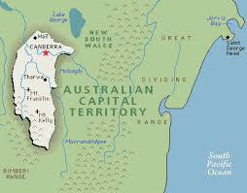
ACT’s map

Slide 5
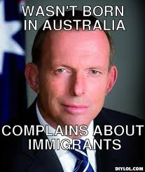
Environment
The environment in Canberra is
Buildings
Bushland
Forest
Red soil (where we were staying there was)

Slide 6
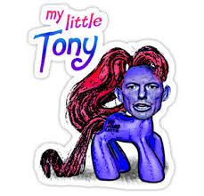
The Changes that have happen
They have move parliament house higher up the mountain where the old parliament house is.

Slide 7
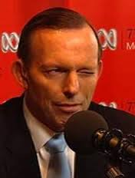
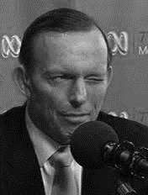
And from our Prime minister
Thanks For Listening
Tony Abbott gives Canberra

